Slide 1
EC2
(Elastic cloud computing)

Slide 2
EC2
Why Ec2 ?
To Launch an Instance or VM or Server.
Backend Process:
Physical server(Host)
Xen Server(OS)
XXXXXXXXXXXxx
XXXX
No.Of Servers

Slide 3
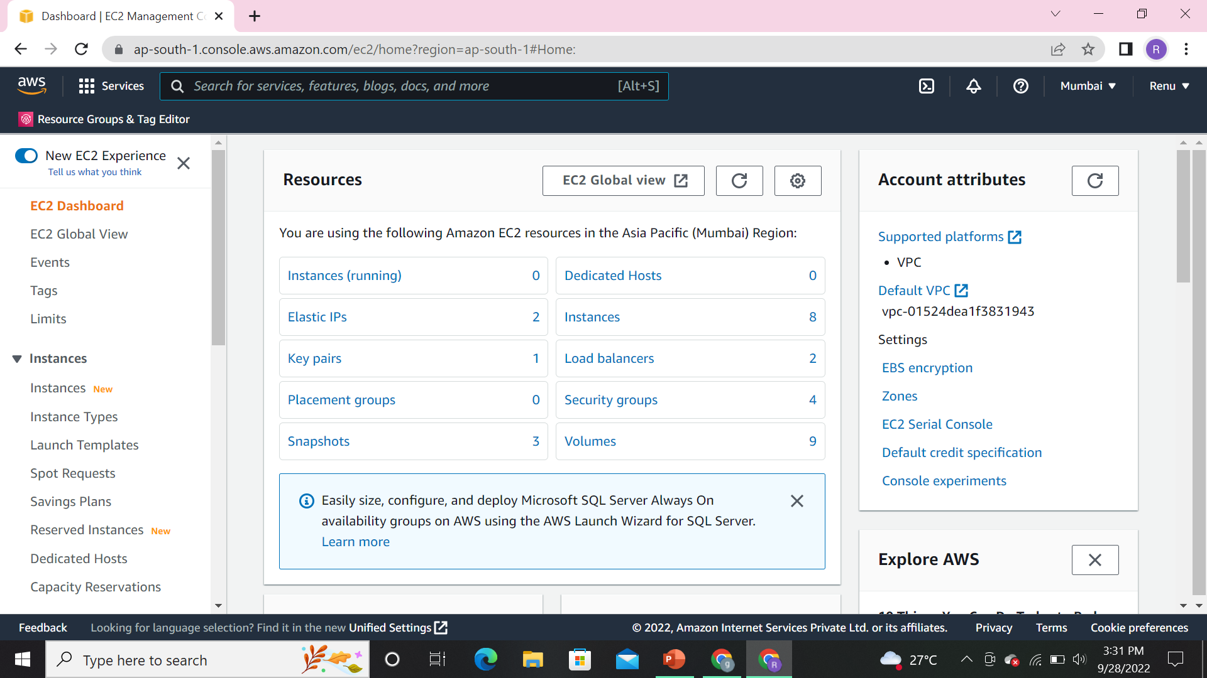
EC2-Instance DashBoard

Slide 4
In EC2 Instance we have 7 Steps to create.
Choose AMI
Choose Instance Type
Configure Instance
Add Storage
Add Tags
Configure Security Group
Review

Slide 5
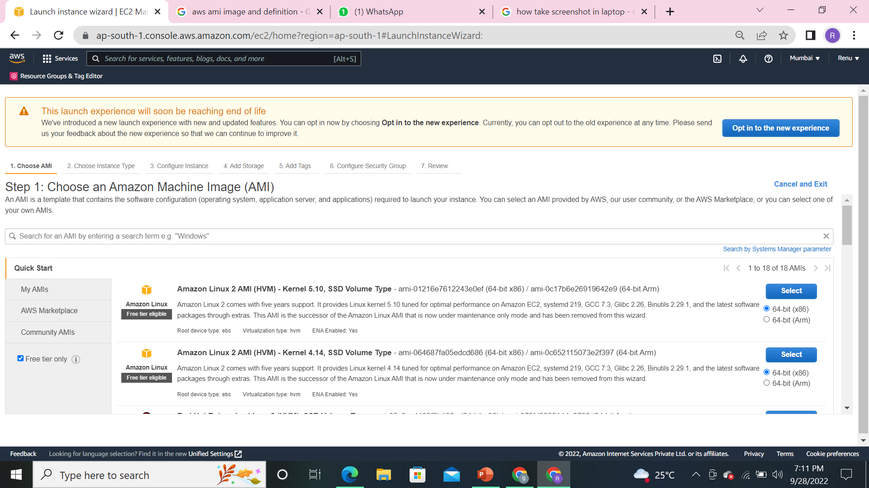
CHOOSE an AMI

Slide 6
Amazon linux Machine is a free tier.which is provided by Amazon providers.
Under Amazon Macine we only use T2 micro.(for freetier only)
For every Image we have AMI number. i.e., unique for every region.
Whenever we used to write a script will use our AMI number.
FREE TIER:
Once you click on freetier ,It only displays the freeversioning.(eligible freetier).
QUICK START:
Once you click on quick start ,It start to display both the free tier and paid one’s.
MY AMI’S:
Once you click on My AMI’s It shows the created images .Images is nothing but (requested server converted as an Image).
Aws marketplace:
Which used for 3rd partytools.

Slide 7
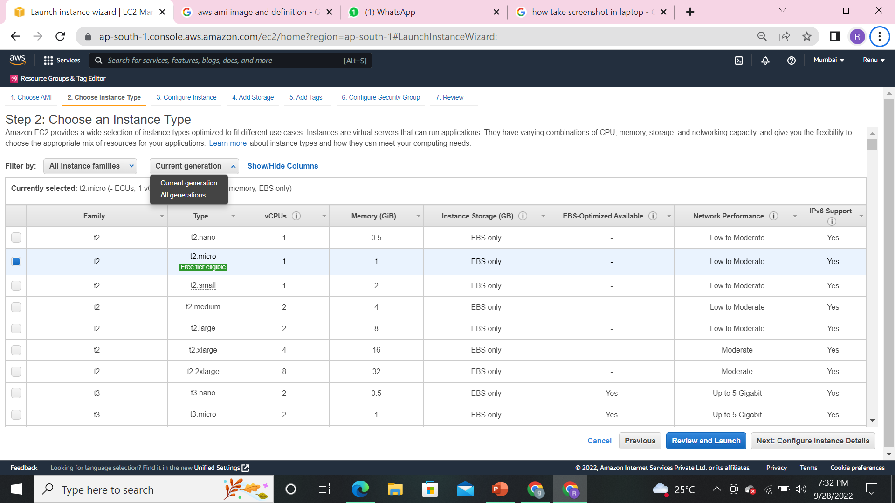
2.TYPE OF INSTANCE

Slide 8
Here,We should choose an instance type,which is a type of RAM and CPU.
Which is used by a General purpose like(website installation,file server).
we have types of instances:
1.Computer Optimization:
whenever we used lessRAM and highCPU .
2.Memory Optimization:
whenever we highRAM and highCPU.
3.Storage optimization:
whenever we used high Storage ang high performance.
4.Accelerating Optimization:
Mainly used for Graphics.

Slide 9
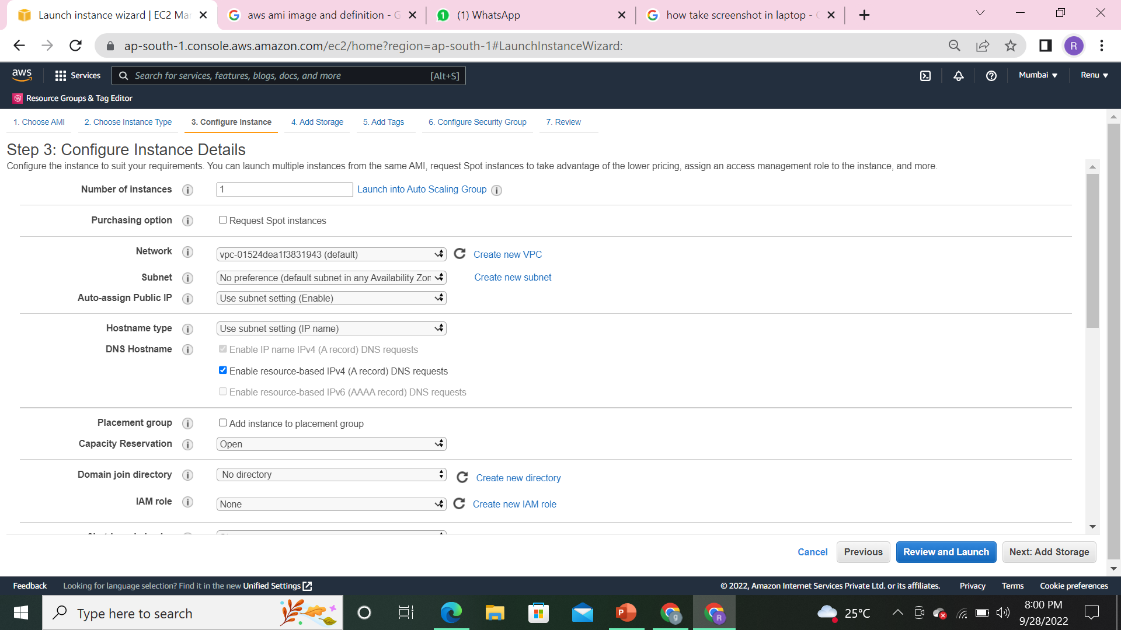
3.CONFIGURE INSTANCE DETAILS

Slide 10
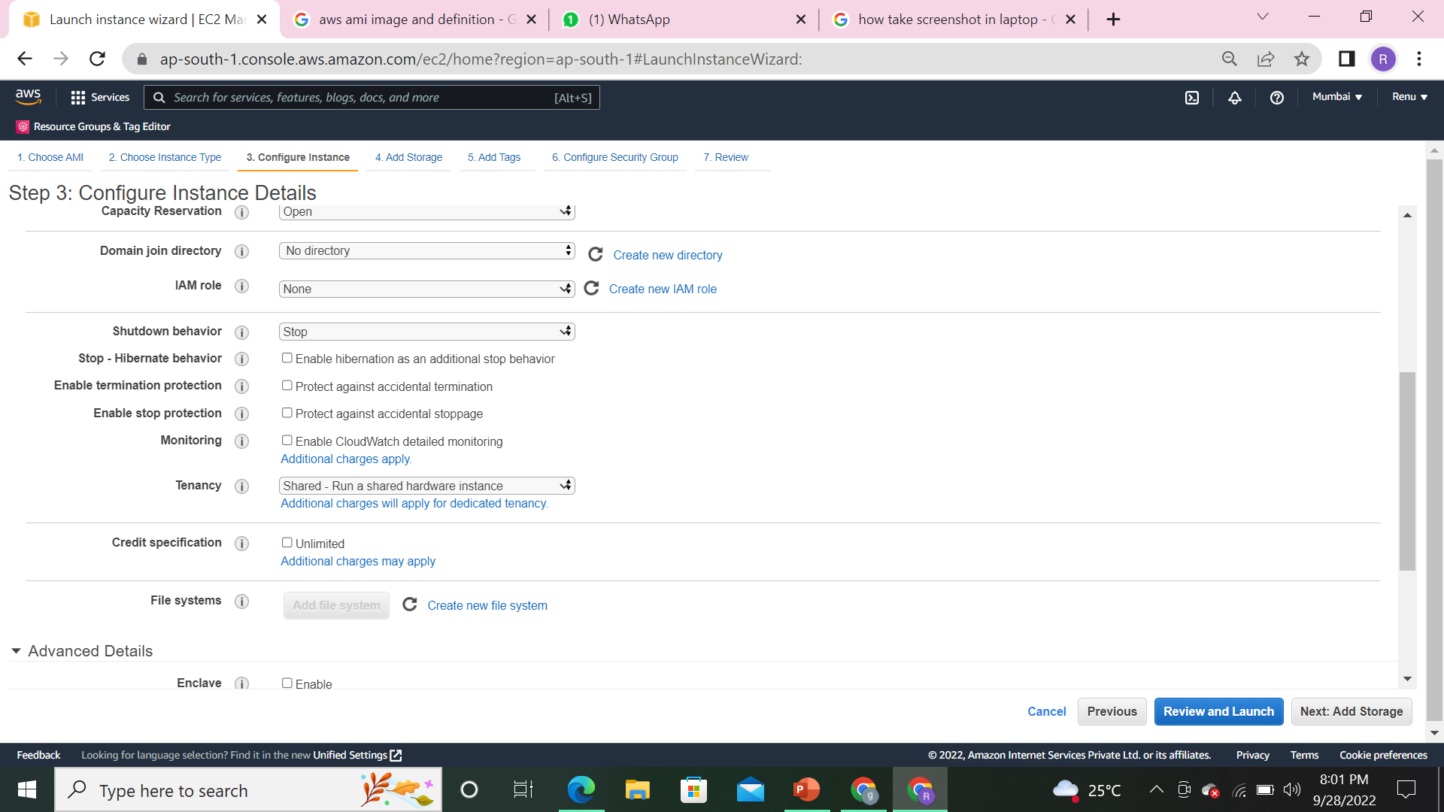
3.CONFIGURE INSTANCE DETAILS

Slide 11
NO.OF INSTANCES: - at a Time we have to create 20 instances by need.
NETWORKING:-select our existing VPC for private network.
SUBNETS:-select our existing subnets for improving speed and performance.
SHUTDOWN BEHAVIORE:-(STOP) Whenever we used to maintain a server(it will get deleted in maintained server) we should go to stop or Terminate.
TENANACY:-1.Shared:-no.of user(no.of companies)+one server.
2.Dedicated:-no.of server+one user(for security)
3.Dedicated Host:-adopting from physical server+xen server+sub servers.

Slide 12
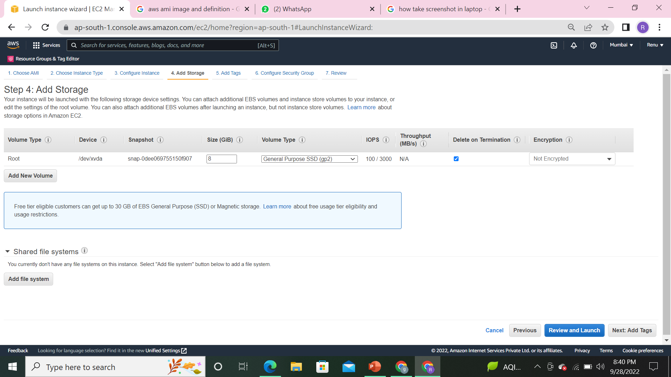
4.ADD STORAGE

Slide 13
Volume Type:-choose your Volume Type(EBS).
Device :-location of your volume stored in.
Snapshot :-whatever snapshot you required.
Volume Type :-General purpose
Size :-How much you required for the server.

Slide 14
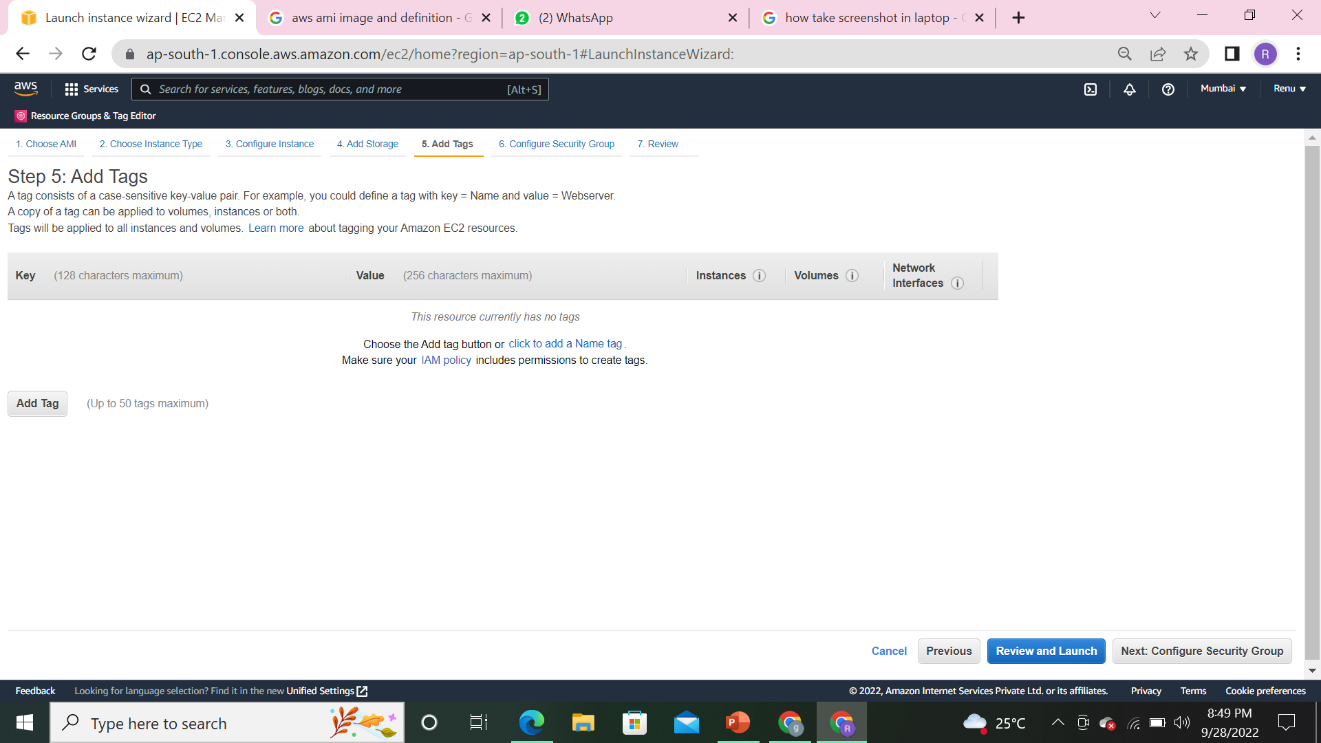
5.ADD TAGS

Slide 15
Tag is nothing but a lable.which is created by Identification in a server.
KEY:-just give a Key name.
Value:-EC2

Slide 16
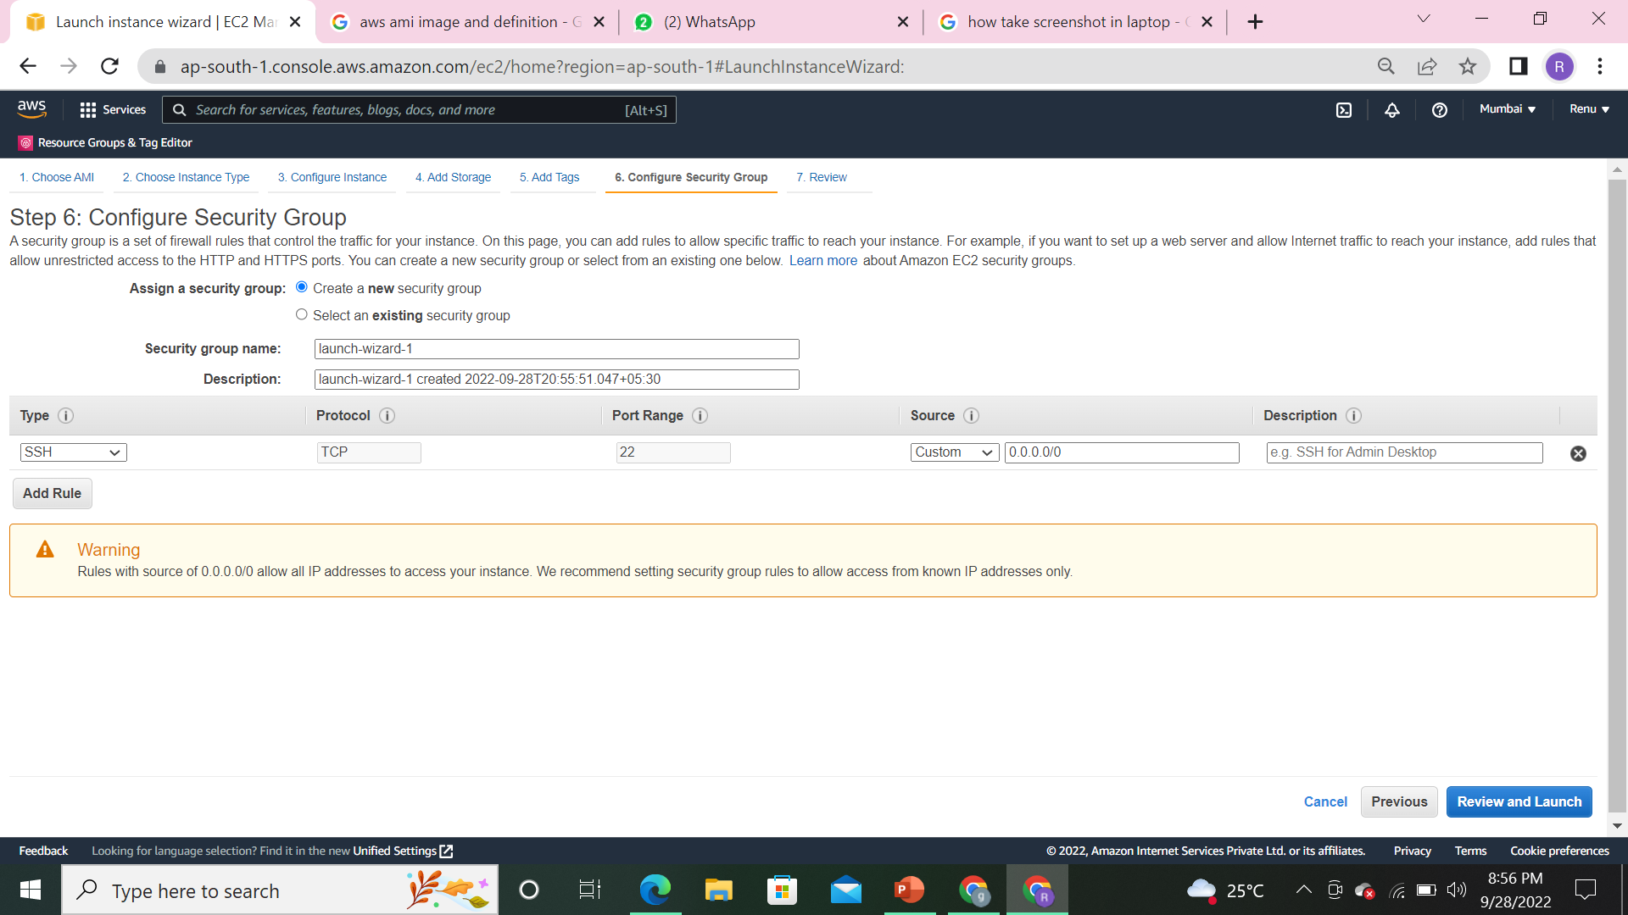
6.CONFIGURE SECURITY GROUP

Slide 17
WHY SECURITY GROUP:
A security group is to create control traffic to your instance.
ASSIGN SECURITY GROUP: 1-Create a new security group:--once you select this option it just show the creating option .
2-select an existing security group:--once you select this option, you can choose existing one.
Again we have 2 types of security options
1.INBOUND:Requested one(whenever your searching in website like facebook,twitter or youtube).
2.OUTBOUND:-Response or gettingback(response from the website).

Slide 18
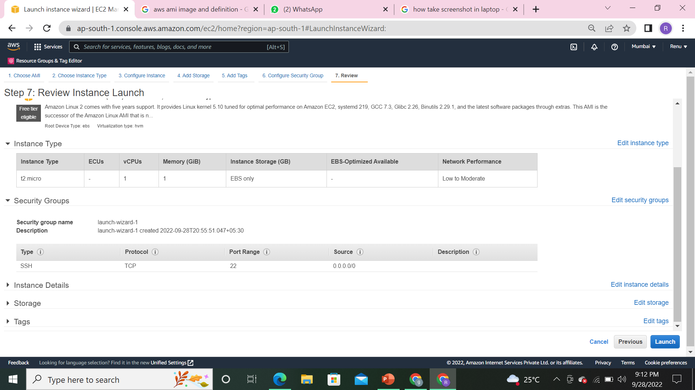
7.REVIEW AND LAUNCH

Slide 19
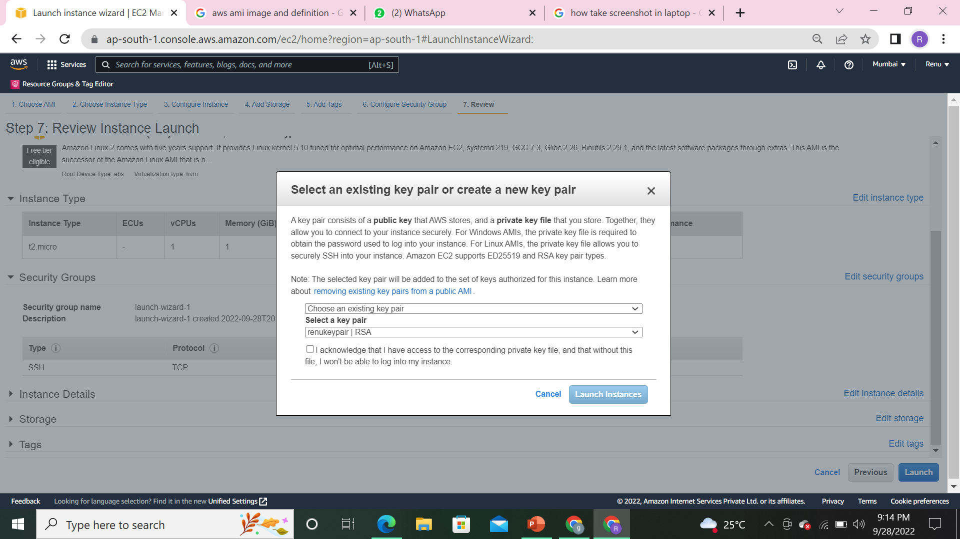

Slide 20
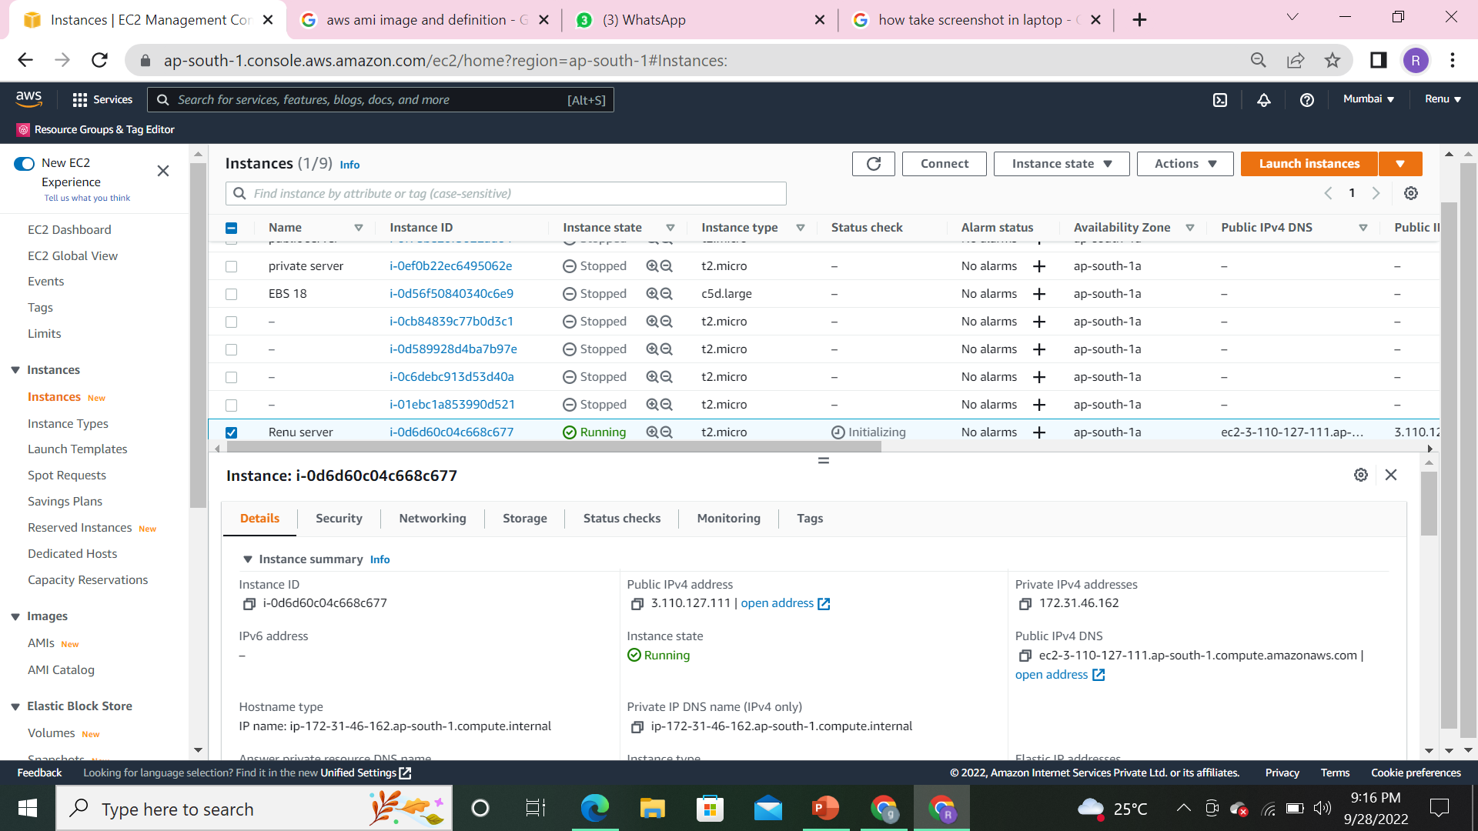
Once you launched an server it is in running state on instance.

Slide 21
THANK YOU

